Slide 1

1. Draw a line of length 100mm and divide it in to 10 equal parts.
Solution:
Draw a line AB of length 100mm using Line command L. Keep Ortho On (F8). Mark the text A and B using MTEXT command (Multi Line Text).

Slide 2

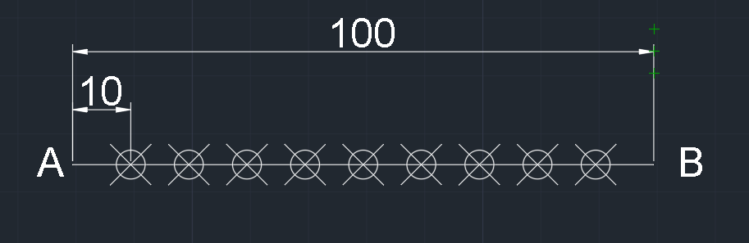
2. Enter Divide (Div) command. Select object to divide
Enter number of segments: 10
Select Utilities – Point Style – Select required point style.
3. Select Linear Dimensioning and specify dimensions.

Slide 3
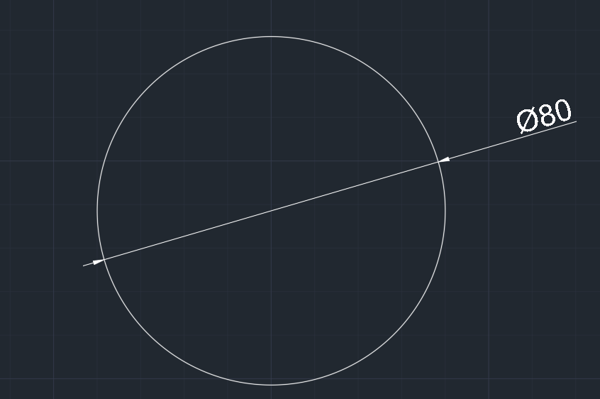
2. Draw a circle of diameter 80mm and divide it in to 12 equal parts.
Solution:
Draw a circle of diameter 80 mm (Radius = 40mm) using Circle command C.
Select Diameter in Dimensioning – Select circle

Slide 4
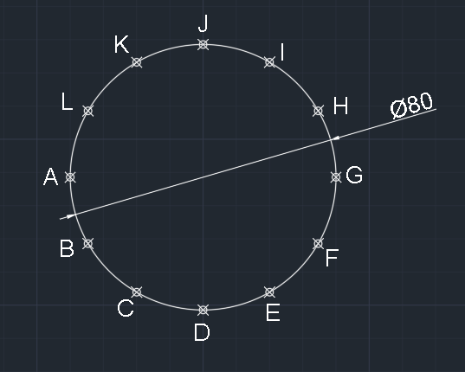
2. Enter Divide (Div) command. Select object to divide
Enter number of segments: 2
Select Utilities – Point Style – Select required point style.
3. Mark the text A to L using MTEXT command (Multi Line Text).

Slide 5
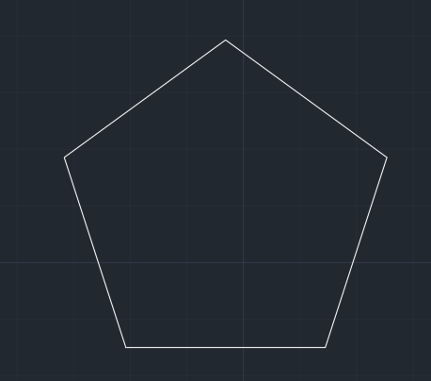
3. Draw a pentagon with diameter 60mm using following two methods.
Inscribe Method
Circumscribe Method
Solution: (i) Inscribe Method
Select Polygon (Pol) command.
Enter no. of sides: 5
Specify center of polygon: Pick a point on screen
Select Inscribed in Circle
Enter radius: 30mm

Slide 6
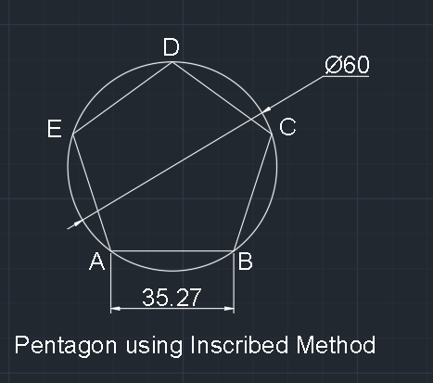
6. Draw a circle with polygon centre as centre and radius 30mm.
7. Select Diameter in Dimensioning – Select circle. Select Linear Dimensioning and specify length of pentagon.
8. Mark the text A to E using MTEXT command (Multi Line Text).

Slide 7
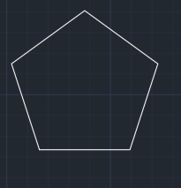
Solution: (ii) Circumscribe Method
Select Polygon (Pol) command.
Enter no. of sides: 5
Specify center of polygon: Pick a point on screen
Select Circumscribed about circle
Enter radius: 30mm

Slide 8
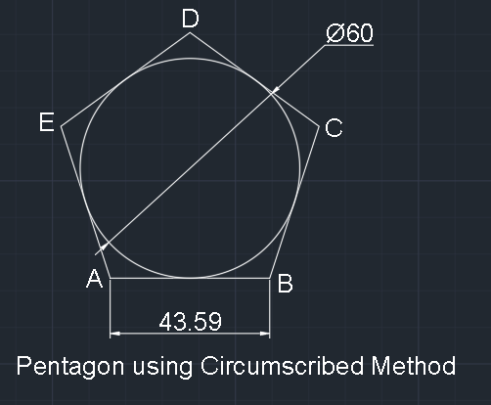
6. Draw a circle with polygon centre as centre and radius 30mm.
7. Select Diameter in Dimensioning – Select circle. Select Linear Dimensioning and specify length of pentagon.
8. Mark the text A to E using MTEXT command (Multi Line Text).

Slide 9
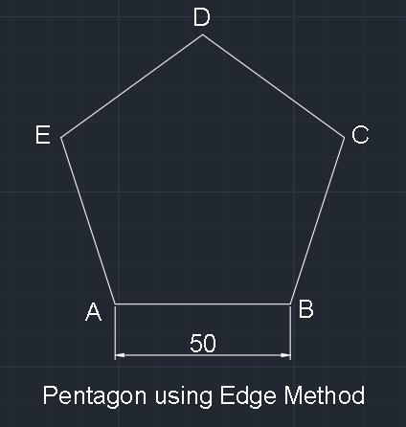
4. Draw a pentagon with 50mm side.
Select Polygon (Pol) command.
Enter no. of sides: 5
Select Edge option
Specify first end point of edge: Select a point
Specify second end point of edge:
Enter value 50 (Ortho on)
Select Linear Dimensioning and
specify length of pentagon.
7. Mark the text A to E using MTEXT command
(Multi Line Text).

Slide 10
5. Draw a hexagon with diameter 60mm using following two methods.
Inscribe Method
Circumscribe Method
Solution: (i) Inscribe Method
Select Polygon (Pol) command.
Enter no. of sides: 6
Specify center of polygon: Pick a point on screen
Select Inscribed in Circle
Enter radius: 30mm
Draw a circle with polygon center as center and radius 30mm.
Select Diameter in Dimensioning – Select circle. Select Linear Dimensioning and specify length of hexagon.
Mark the text A to F using MTEXT command (Multi Line Text).

Slide 11
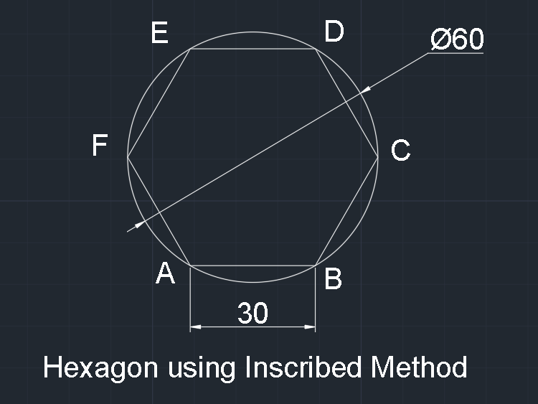

Slide 12
Solution: (ii) Circumscribe Method
Select Polygon (Pol) command.
Enter no. of sides: 6
Specify center of polygon: Pick a point on screen
Select Circumscribed about Circle
Enter radius: 30mm
Draw a circle with polygon center as center and radius 30mm.
Select Diameter in Dimensioning – Select circle. Select Linear Dimensioning and specify length of hexagon.
Mark the text A to F using MTEXT command (Multi Line Text).

Slide 13
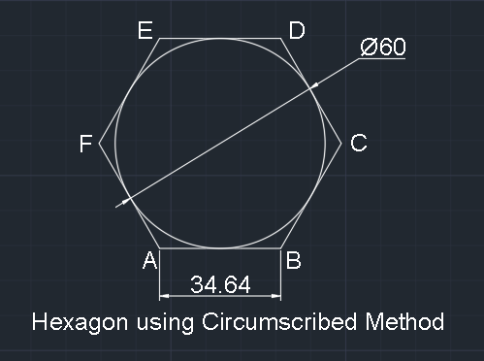

Slide 14
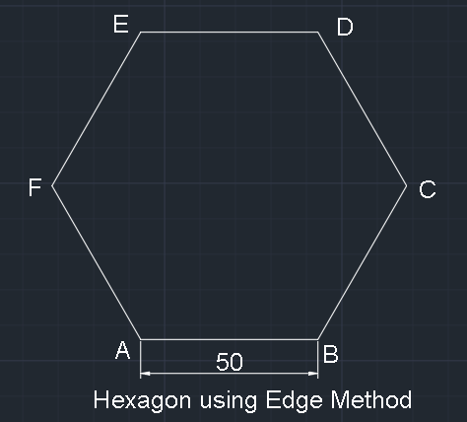
6. Draw a hexagon with 50mm side.
Select Polygon (Pol) command.
Enter no. of sides: 6
Select Edge option
Specify first end point of edge: Select a point
Specify second end point of edge:
Enter value 50 (Ortho on)
Select Linear Dimensioning and
specify length of hexagon.
7. Mark the text A to E using MTEXT command
(Multi Line Text).

Slide 15
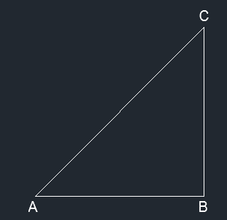
7. To construct a regular polygon (say a pentagon) given the length of the side 40mm (GENERAL METHOD)
Solution:
Draw lines AB AND BC with lengths of 40mm using Line command L. Draw a line joining A and C using Line command L. Mark the text using MTEXT command.

Slide 16
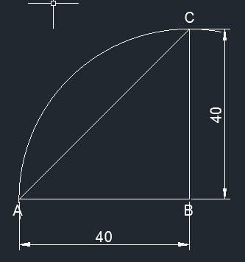
2. Draw a circle with 40mm radius and B as centre using Circle command C. Trim the extra portion of circle using Trim command TR.

Slide 17
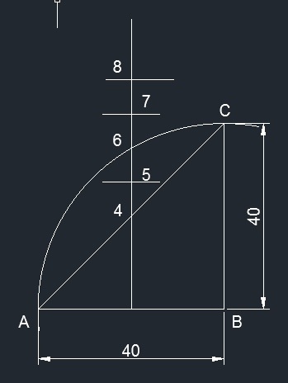
3. Create a bisecting line at a distance of 20mm from BC using Offset command O.
4. Mark point 4 at the intersection of AC and bisecting line and 6 at the intersection of arc and bisecting line. Mark the points using MTEXT command.
5. Create a point at the midpoint of 4 and 6 using Offset command O. Mark the point as 5 using MTEXT command.
6. With offset command O, Create a line at 8 with distance equal to 4-6.
7. Create a point at the midpoint of 6 and 8 using Offset command O. Mark the point as 7 using MTEXT command.

Slide 18
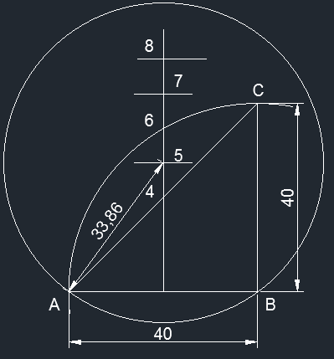
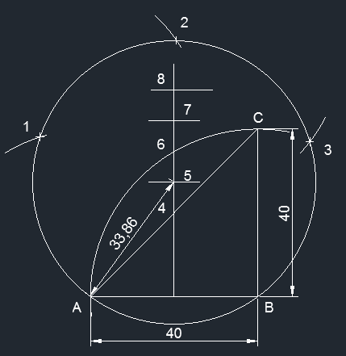
8. With A5 radius, 5 as centre draw a circle using Circle command C.
9. With AB radius, A as centre draw an arc on circle using Circle command C. Mark a point 1 at the intersection of two circles using MTEXT command.
10. Using above procedure, draw arcs 2, 3 for pentagon shape. Center for 2 arc is 1 and center for 3 arc is 2.

Slide 19
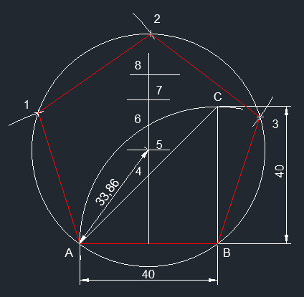
11. Join points A-1, 1-2, 2-3, 3-B using Line command L.
12. Final diagram is the pentagon shape.

Slide 20
8. To construct a regular polygon Hexagon given the length of the side 40mm (GENERAL METHOD)
Solution:
Draw lines AB AND BC with lengths of 40mm using Line command L. Draw a line joining A and C using Line command L. Mark the text using MTEXT command.

Slide 21
2. Draw a circle with 40mm radius and B as centre using Circle command C. Trim the extra portion of circle using Trim command TR.

Slide 22
3. Create a bisecting line at a distance of 20mm from BC using Offset command O.
4. Mark point 4 at the intersection of AC and bisecting line and 6 at the intersection of arc and bisecting line. Mark the points using MTEXT command.
5. Create a point at the midpoint of 4 and 6 using Offset command O. Mark the point as 5 using MTEXT command.
6. With offset command O, Create a line at 8 with distance equal to 4-6.
7. Create a point at the midpoint of 6 and 8 using Offset command O. Mark the point as 7 using MTEXT command.

Slide 23
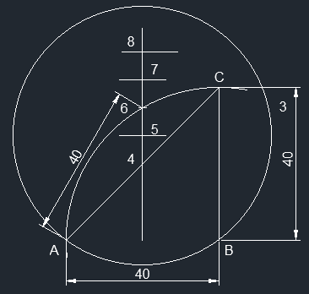
8. With A6 radius, 6 as centre draw a circle using Circle command C.
9. With AB radius, A as centre draw an arc on circle using Circle command C. Mark a point 1 at the intersection of two circles using MTEXT command.

Slide 24
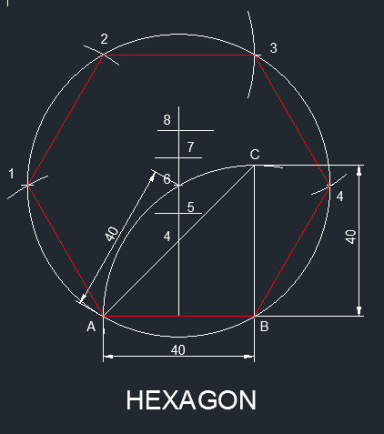
10. Using above procedure, draw arcs 2, 3, 4 for Hexagon shape. Center for 2 arc is 1, center for 3 arc is 2 and center for 4 arc is 3.
11. Join points A-1, 1-2, 2-3, 3-4, 4-B using Line command L.
12. Final diagram is the Hexagon shape.

Slide 25
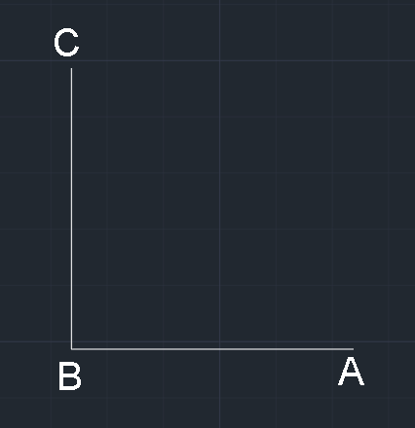
9. Draw a bisecting line between two lines which are at an angle of 90°, Lines length – 50mm.
Solution:
Draw lines OA and OB with lengths of 50mm using Line command L. Mark the text using MTEXT command.

Slide 26
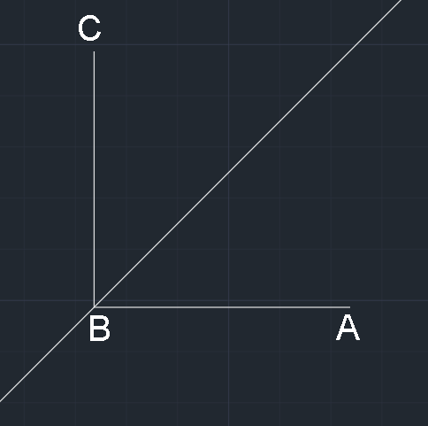
2. Enter Construction Line (XL) command. Select Bisect option.
3. Specify angle vertex point: Select intersection point of two lines
4. Specify angle start point: Select a point on one line
5. Specify angle end point: Select a point on second line

Slide 27
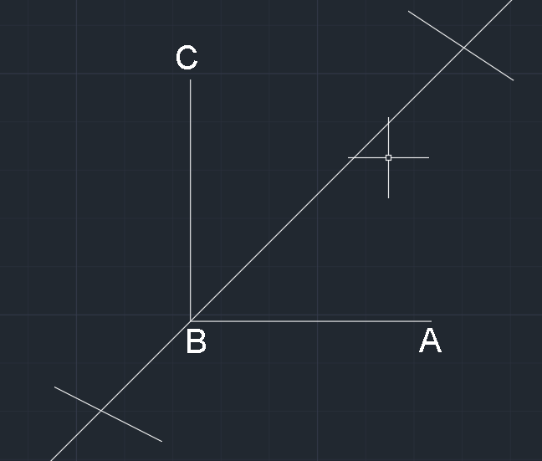
6. Trim extra portion: Draw two lines
7. Select Trim (Tr) command – Press Enter two times
8. Select on bisecting line which is not required.
9. Select Angular Dimensioning and specify angles.

Slide 28
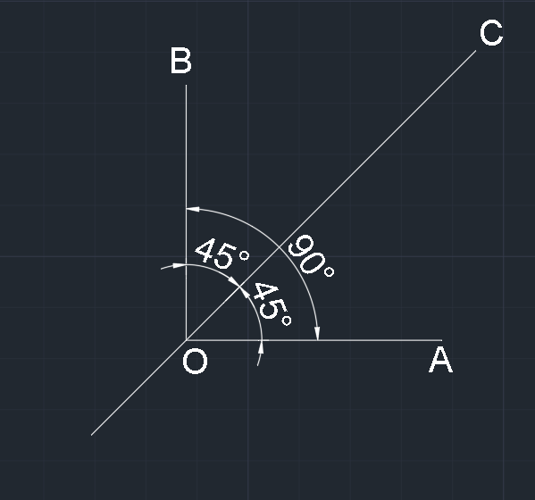

Slide 29
9. Draw an ellipse with major axis 110mm and minor axis 70mm long.
Solution:
Select Ellipse (EL) command.
Specify axis end point of ellipse.
Specify other endpoint of axis: Give 110mm in horizontal direction
Specify distance to other axis: Give 35mm in vertical direction
Mark the points using MTEXT command.
Dimension using Linear Dimensioning.

Slide 30
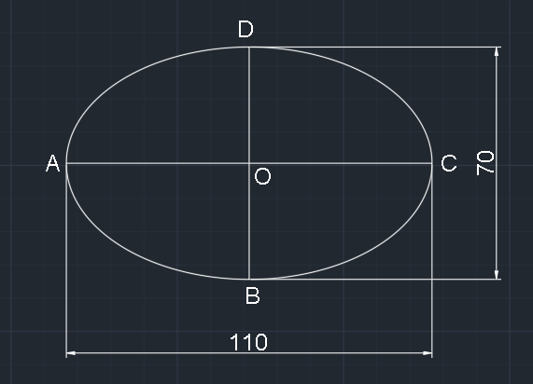

Slide 31
10. A plot is in the rectangular shape of size 110*50mm. Inscribe an elliptical lawn in it.
Solution:
Draw a rectangle using REC command – Draw first end point of rectangle. Select Dimension option – Enter length 110mm and width 50mm.
Draw lines AC and BD from midpoints of rectangle
Mark the points using MTEXT command.
Select Ellipse (EL) command. Select Center option
Specify center of ellipse: Intersection point (O) of AC and BD.
Specify axis endpoint: Select point C
Specify distance to other axis: Select Point D.
Dimension using Linear Dimensioning.

Slide 32
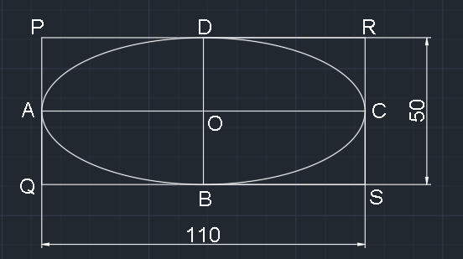

Slide 33
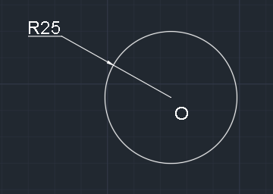
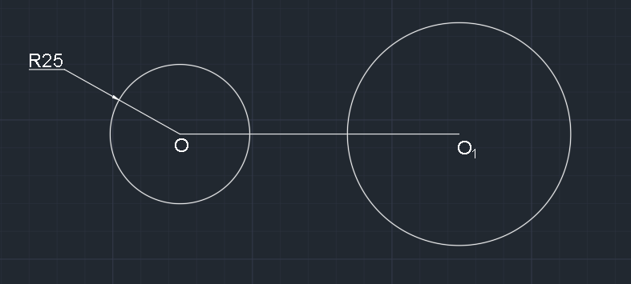
10. Draw exterior and interior tangents connecting two circles having 25mm and 40mm radii , their centers being 100mm apart.
Solution:
Draw a circle of 25mm radius using Circle command C. Mark center point as O using MTEXT command.
2. Draw a horizontal line of length 100mm from point O. Mark center point as O1 using MTEXT command. Draw a circle of 40mm radius taking O1 as center using Circle command C

Slide 34
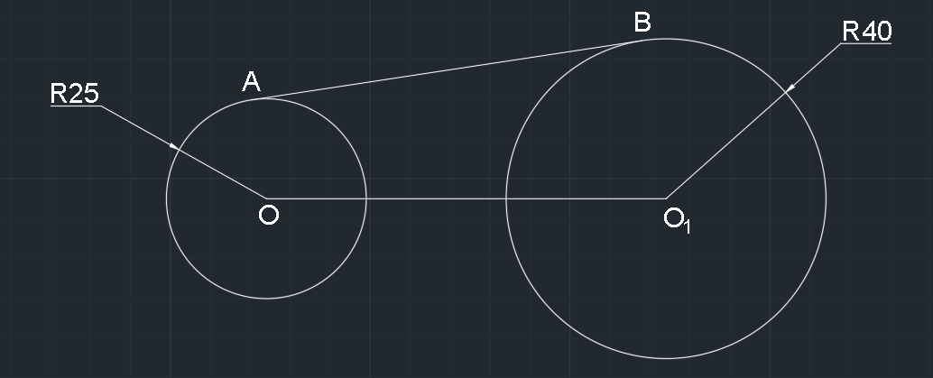
3. Take tangent option in OSNAP settings. Draw a line by selecting tangent points on exterior of both circles using Line command L. Mark text using MTEXT command.
4. Take tangent option in OSNAP settings. Draw a line by selecting tangent points on interior of both circles using Line command L. Mark text using MTEXT command.

Slide 35
